Slide 1
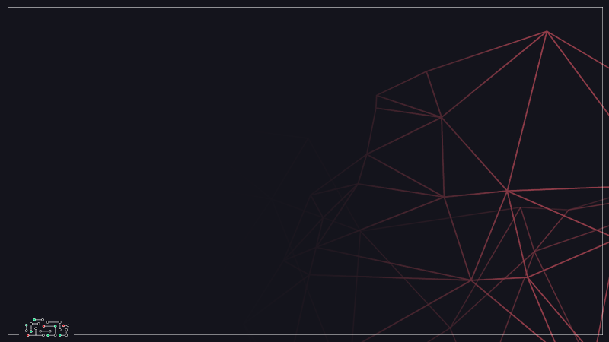
Introduction and KNN
Evolve Machine Learners
Notes:
https://techxplore.com/news/2018-02-google-ai-heart-disease-pictures.html

Slide 2
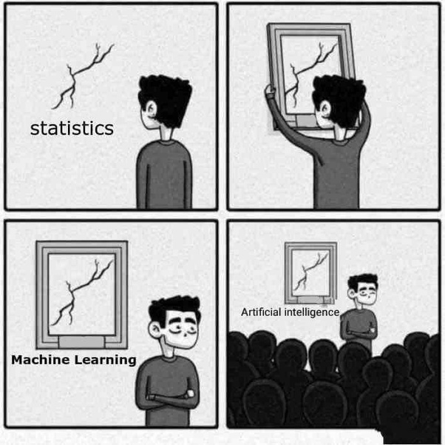
What is Machine Learning?

Slide 3
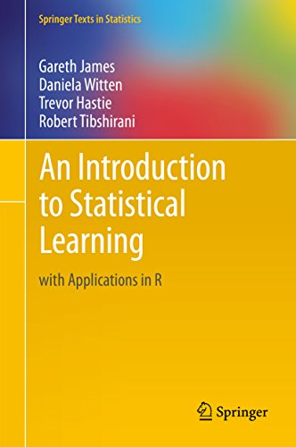
https://www-bcf.usc.edu/~gareth/ISL/ISLR%20First%20Printing.pdf?

Slide 4
y
Independent Variables
Reponse
X
Dependent Variables
Predictors
Features
Input Variables
Output Variables

Slide 5
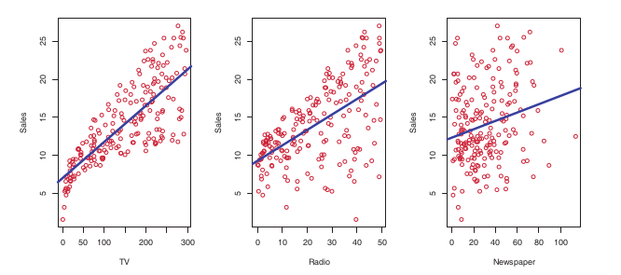


Slide 6
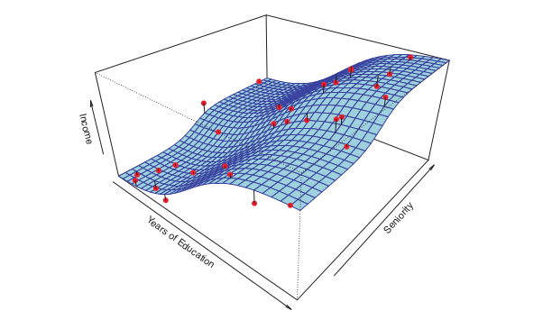
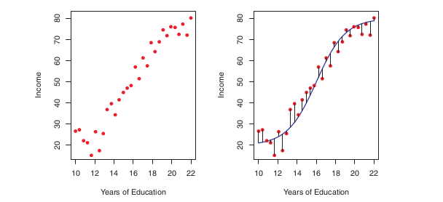
Why estimate f?
Prediction
Inference

Slide 7

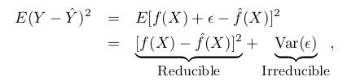
Prediction (black box)
Reducible Error
Irreducible Error

Slide 8
Inference (not black-box)
Which predictors are associated with the response? (important predictor)
What is the relationship between the responses and each predictors? (positive or negative)
Can the relationship between Y and predictor explained by linear equation or is the relationship more complex? (linear or non-linear)

Slide 9

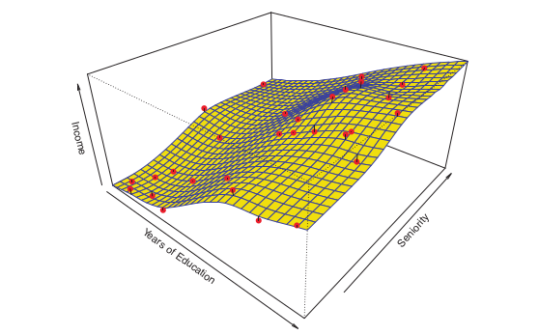
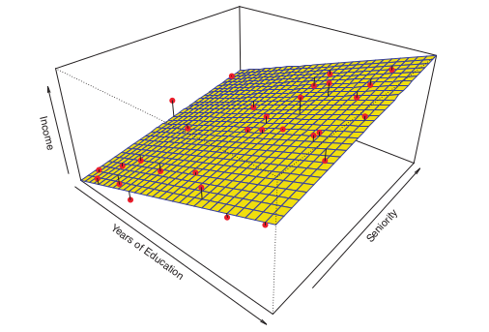
Linear fit (flexible or not flexible?)
Spline fit (smooth)
Parametric Methods
Non-parametric Methods

Slide 10
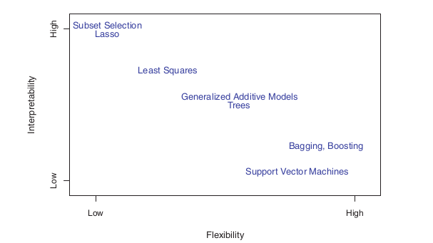
Tradeoff between Flexibility and Interpretability

Slide 11
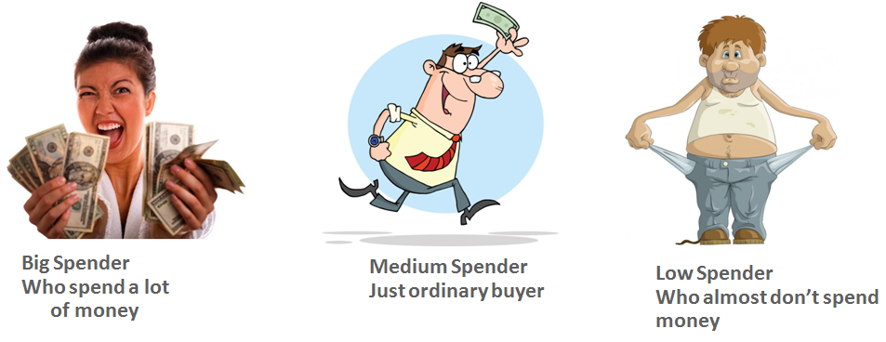
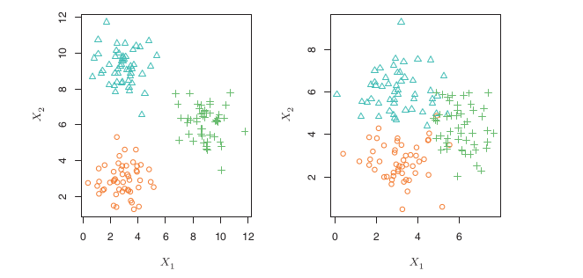


Supervised vs Unsupervised
Unsupervised??
Unsupervised??

Slide 12
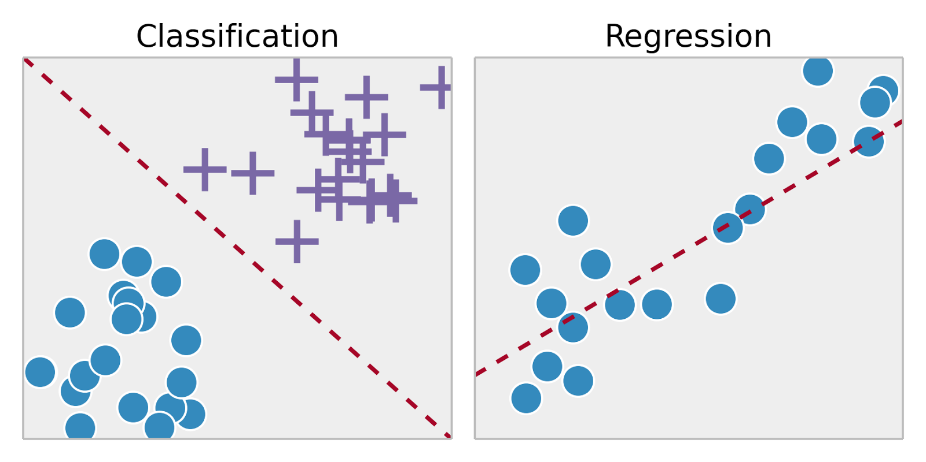
Classification vs Regression

Slide 13
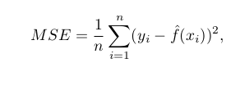

Quality of Fit
Regression
Classification
Mean Squarred Error
Error Rate

Slide 14
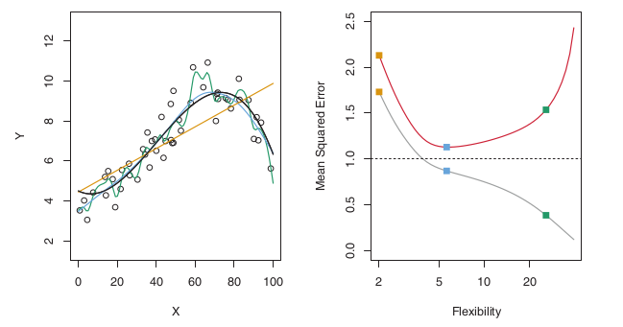
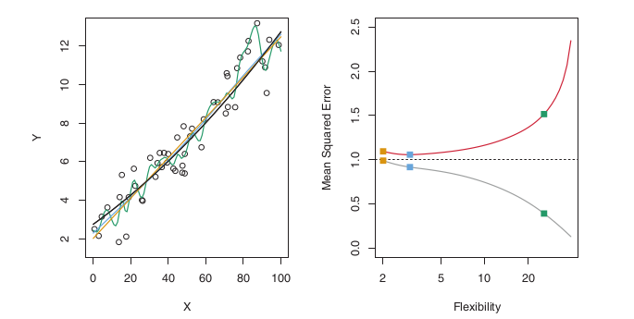
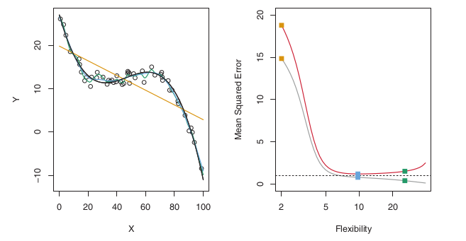
Flexibility vs Error (Regression setting)

Slide 15
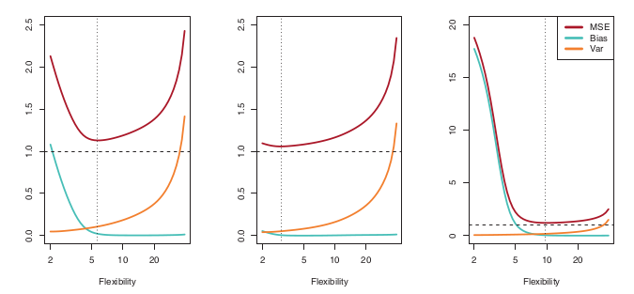

Bias-Variance Tradeoff
Tradeoff = Low bias - Low variance
High bias - Low variance = Linear Model
Low bias - High variance = Complex Model

Slide 16
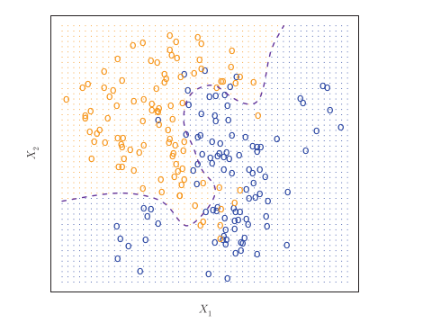


Bayes Classifier
Error Rate (Irreducible error) :

Slide 17
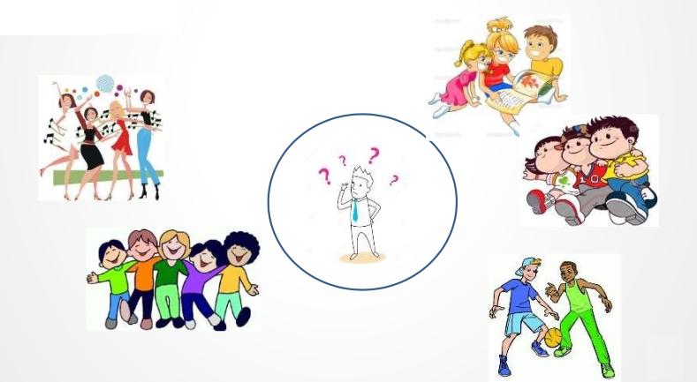
K Nearest Neighbor (KNN)
“Tell me about your friends (who your neighbors are) and I will tell you who you are”

Slide 18
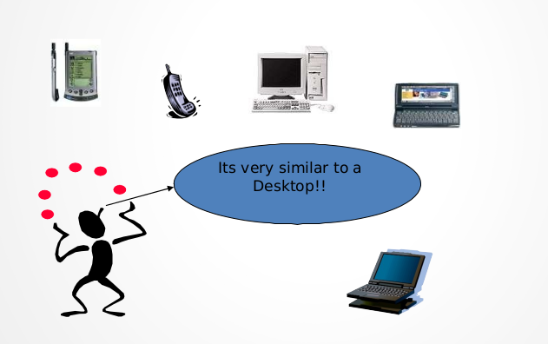
K-Nearest Neighbors
Memory-Based Reasoning
Example-Based Reasoning
Instanced-Based Reasoning
Lazy Learning

Slide 19
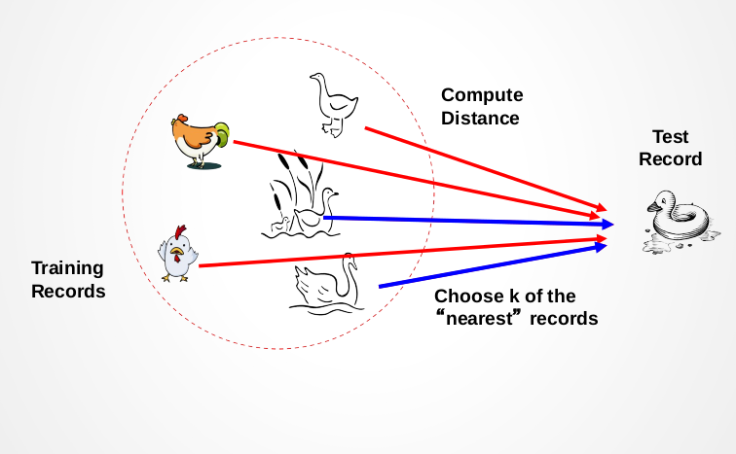
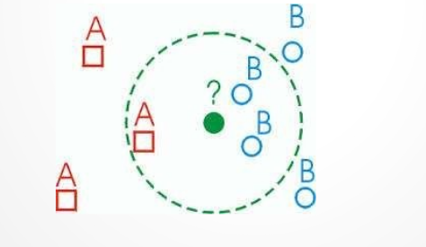

Choose K neighbors
Measure distance
KNN is non-parametric

Slide 20
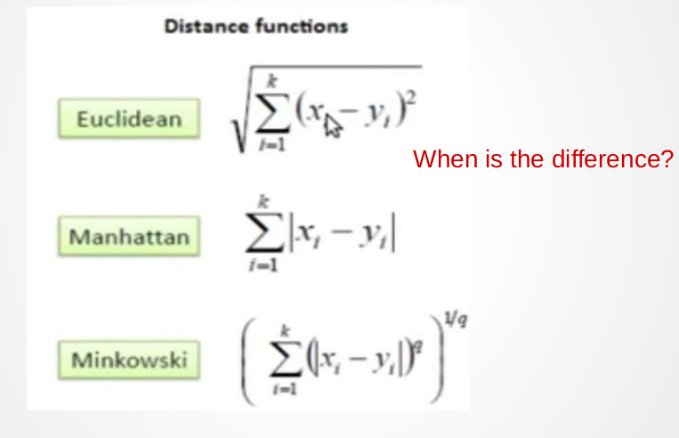
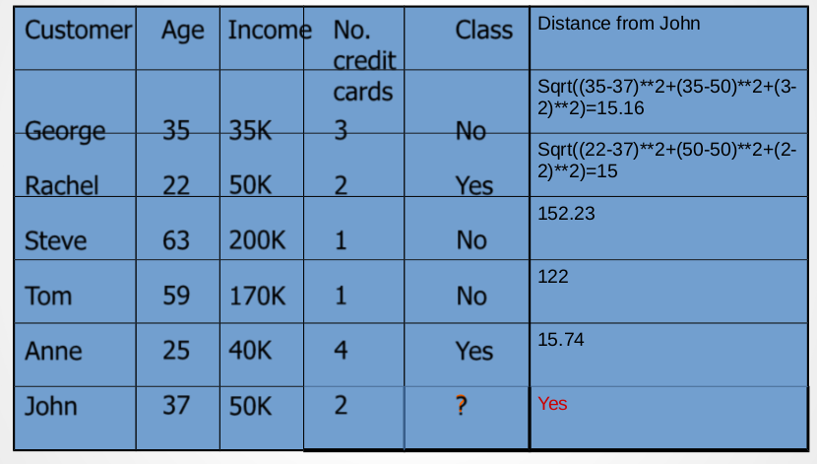
Distance Metrics

Slide 21
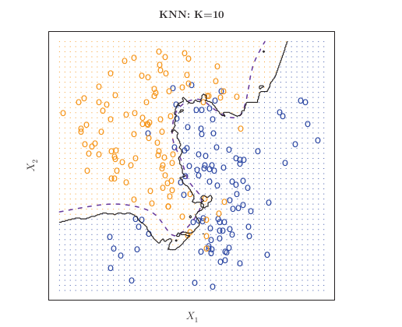
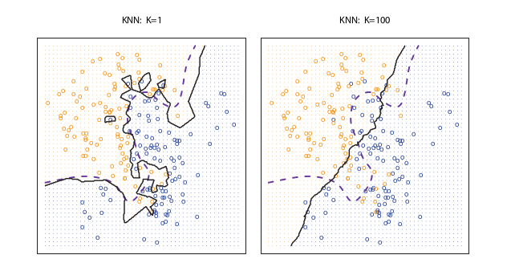
“Given the proper amount of K, KNN close to Bayes Classifier

Slide 22
Weakness
Takes more time to classify
Choose K may be tricky
Need large number of samples for accuracy
Strength
Very simple and intuitive
Can be applied for any distribution
Good if the number of samples is large enough

Slide 23
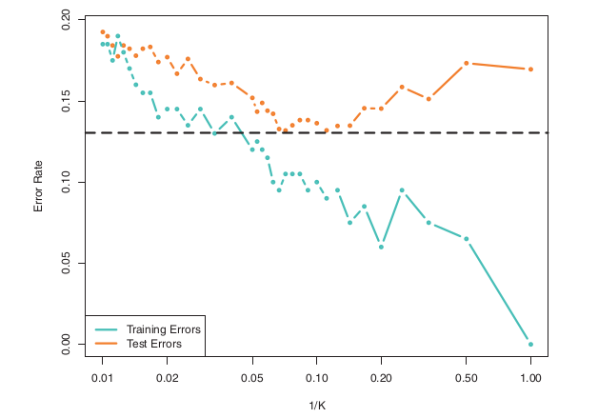
Flexibility vs Error (Classification setting)

Slide 24



Cross Validation
Divide data into three sets, training, validation, and test sets
Find the optimal model on the training set, and use the test set to checks its predictive capability
See how well the model performs on the test set
The validation error gives an unbiased estimate of the predictive power of a model

Slide 25
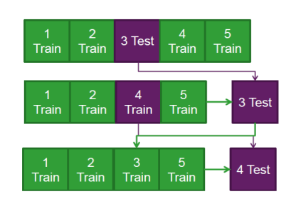
Split the data into 5 samples (K = 5)
Fit a model to the training samples and use the test sample to calculate a CV metric
Repeat the process for the next sample, until all samples have been used to either train or test the model

Slide 26
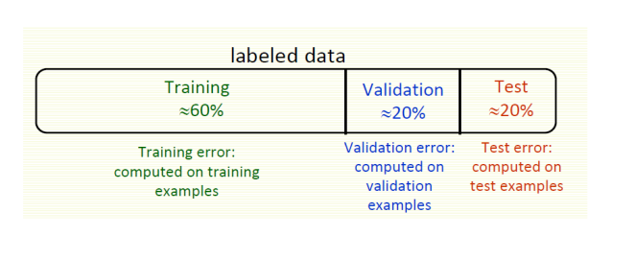
Training/Validation

